Slide 1


Folk and Fairy tales Ontology
Once Upon A Time…
Yasar Mahomed Abbas Franziska Pannach
Danielle Russell
Yuvika Singh

Slide 2

Objective and Motivation

Slide 3

Background
Substantial part of oral history.
Important role in the cultural heritage of regions, nations or cultural minorities.
Grimm brothers
African folk tales

Slide 4
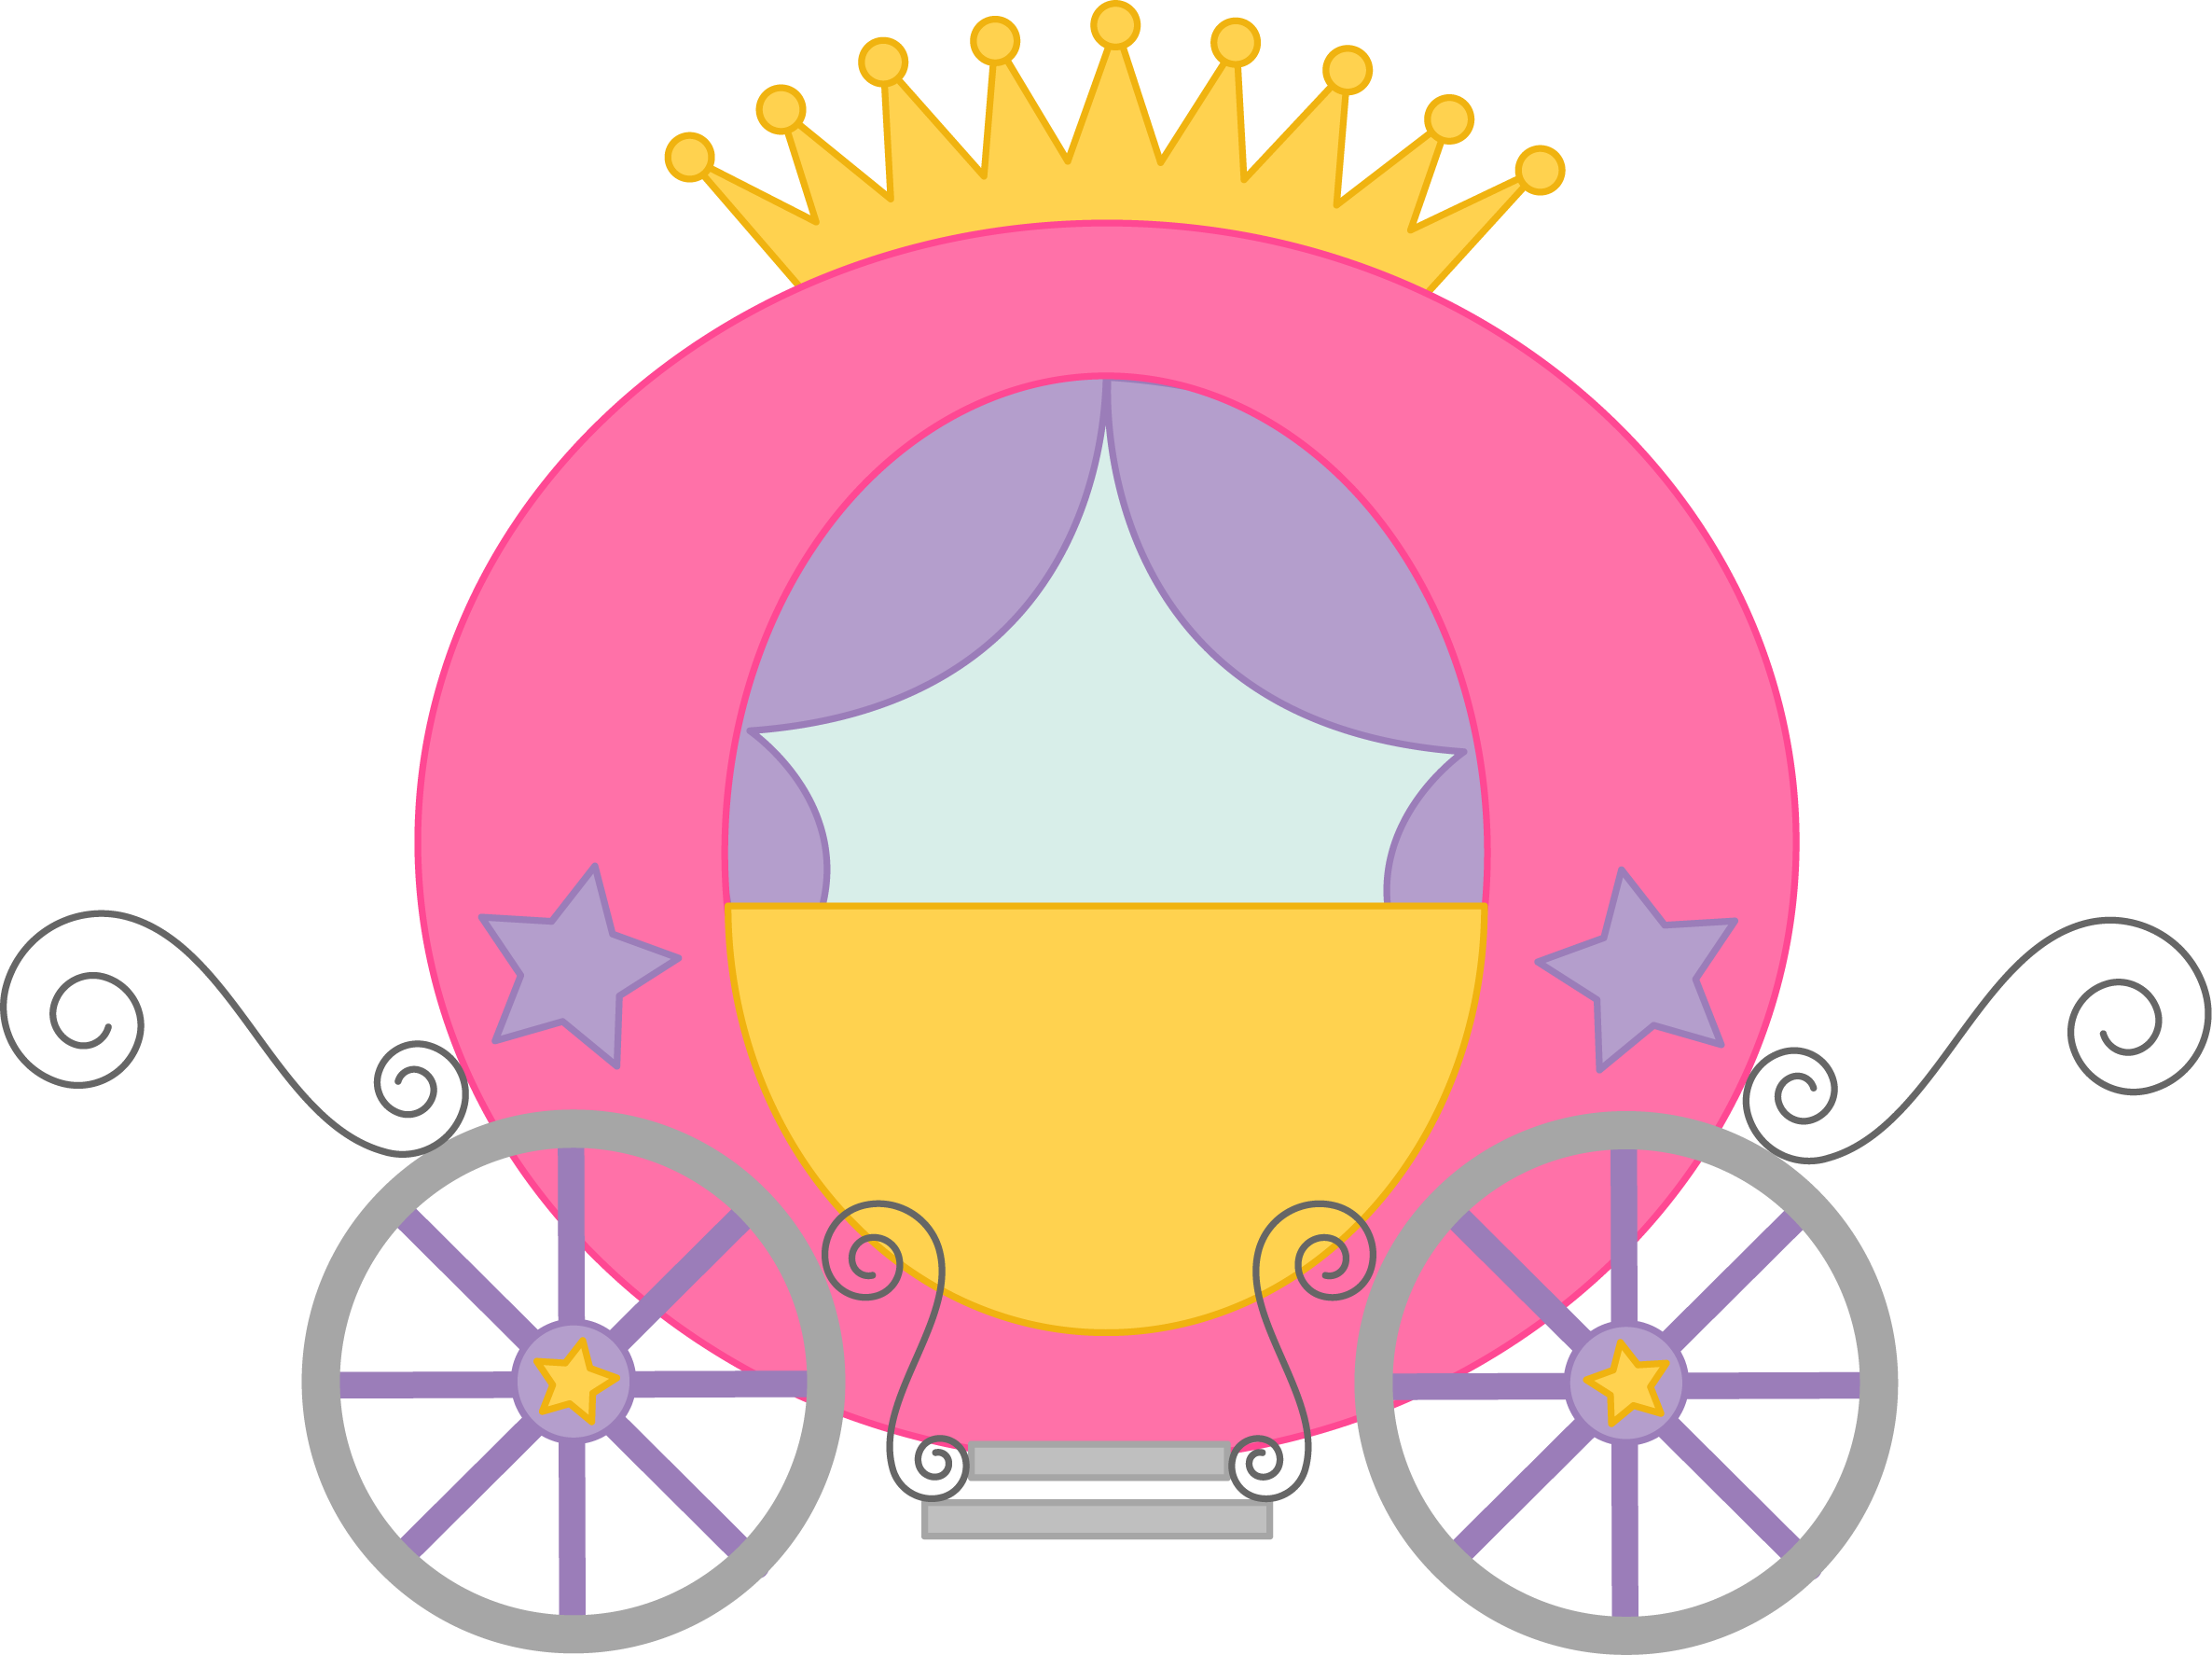
Aims
African folk tales following
Russian folklorist Vladimir Propp.
The ontology contains:
The Proppian functions and entities encoded within.
Specic folk tale motifs according to the Aarne-Thompson-Uther Index (ATU).

Slide 5
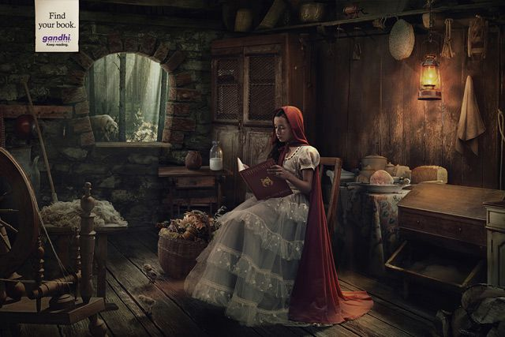
Domain

Slide 6
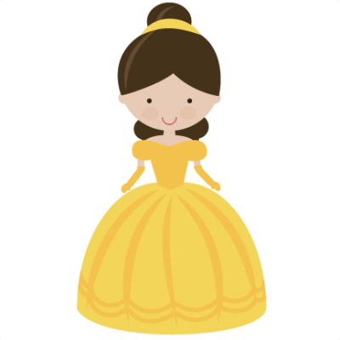
Motifs Indices
Folk tales motifs are classified by two motif indices:
The Aarne-Thompson Uther index (ATU)
The Thompson-Motif-Index (TMI)

Slide 7
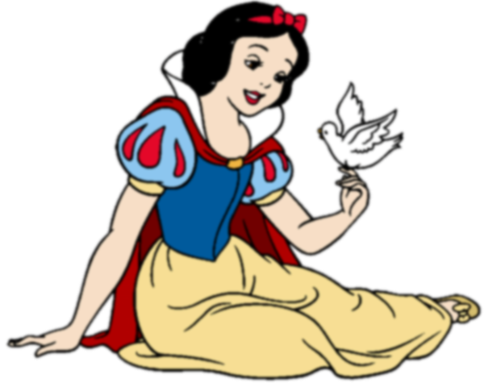
Propp Functions
4 Axioms:
The functions of characters
The number of functions known to the fairy tale is limited.
The sequence of functions is always identical.
All fairy tales are of one type in regard to their structure.

Slide 8

Conceptualization

Slide 9
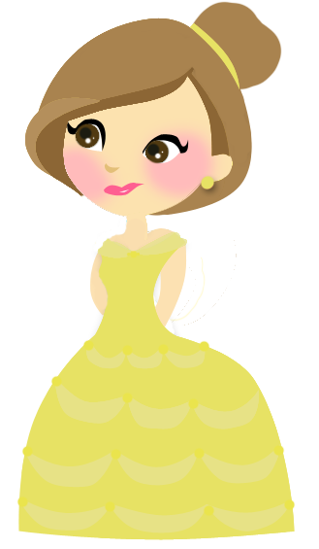
Definition of the Ontology
Properties < C,I,A,R >
c_{i} ϵ C set of Classes
i_{i} ϵ I set of Instances
a_{i} ϵ A set of Axioms
r_{i} ϵ R set of Relations

Slide 10
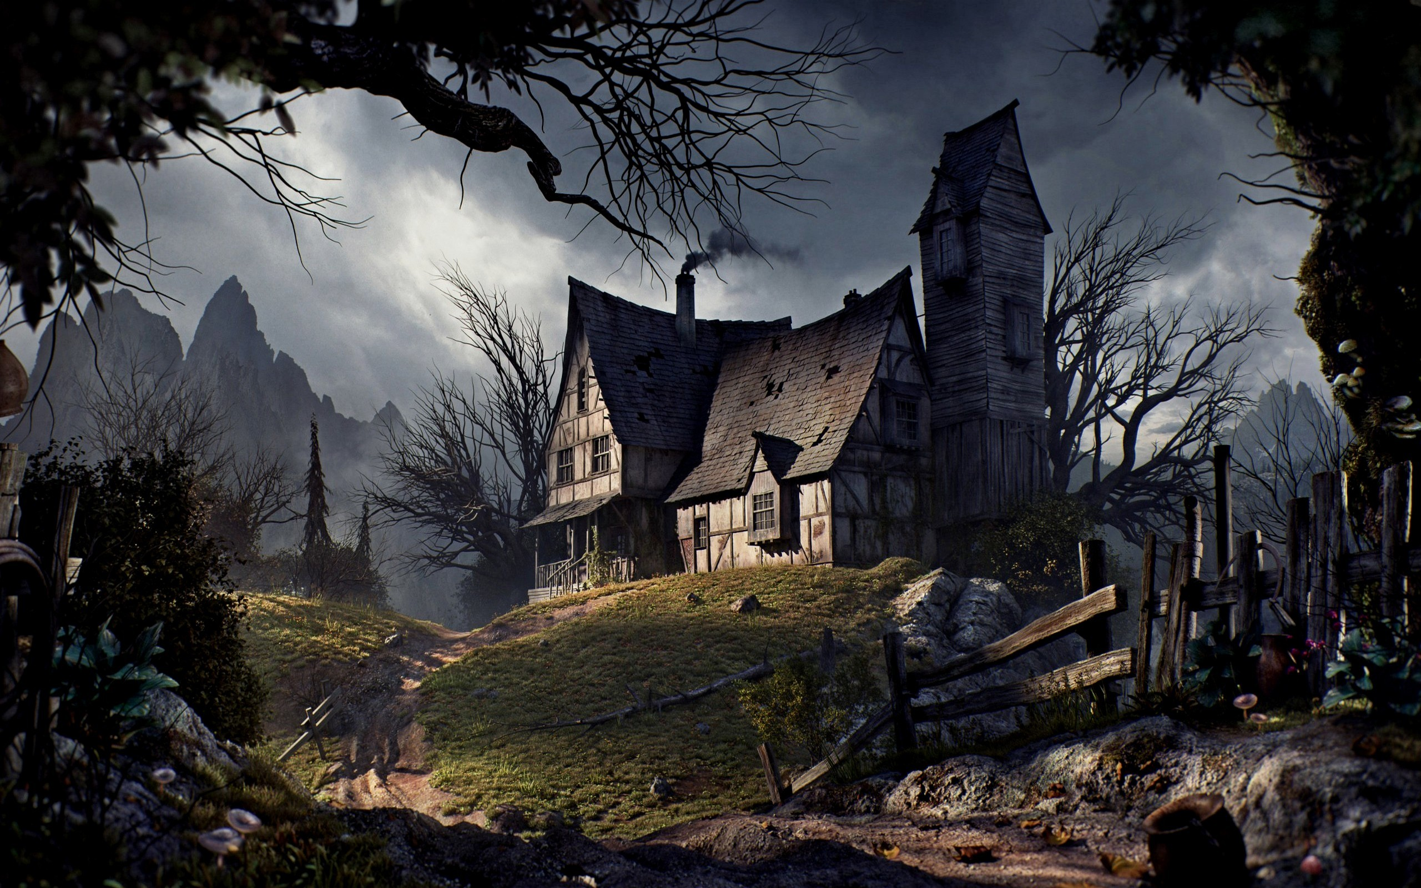
Annotations

Slide 11
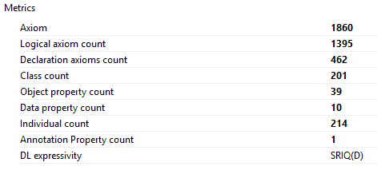

Slide 12

Conclusion

Slide 13

Overview
Sophisticated ontology
Proppian theory
Allows users to add more stories
Ontology can be alone standing or it can be connected to Declerck et.al.'s work
Long term:
Modelling the relationship between the functions
Dramatis Personae

Slide 14
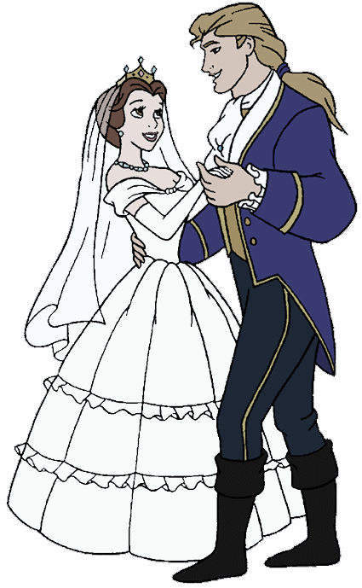
Further Work
Adding more annotations
The more fairy tales of different origin are added, the more and complex the deductions about the structure and verbalisation of African folk tales can be made.
Compare these findings about African folk tales to studies of folk tales of different origin

Slide 15
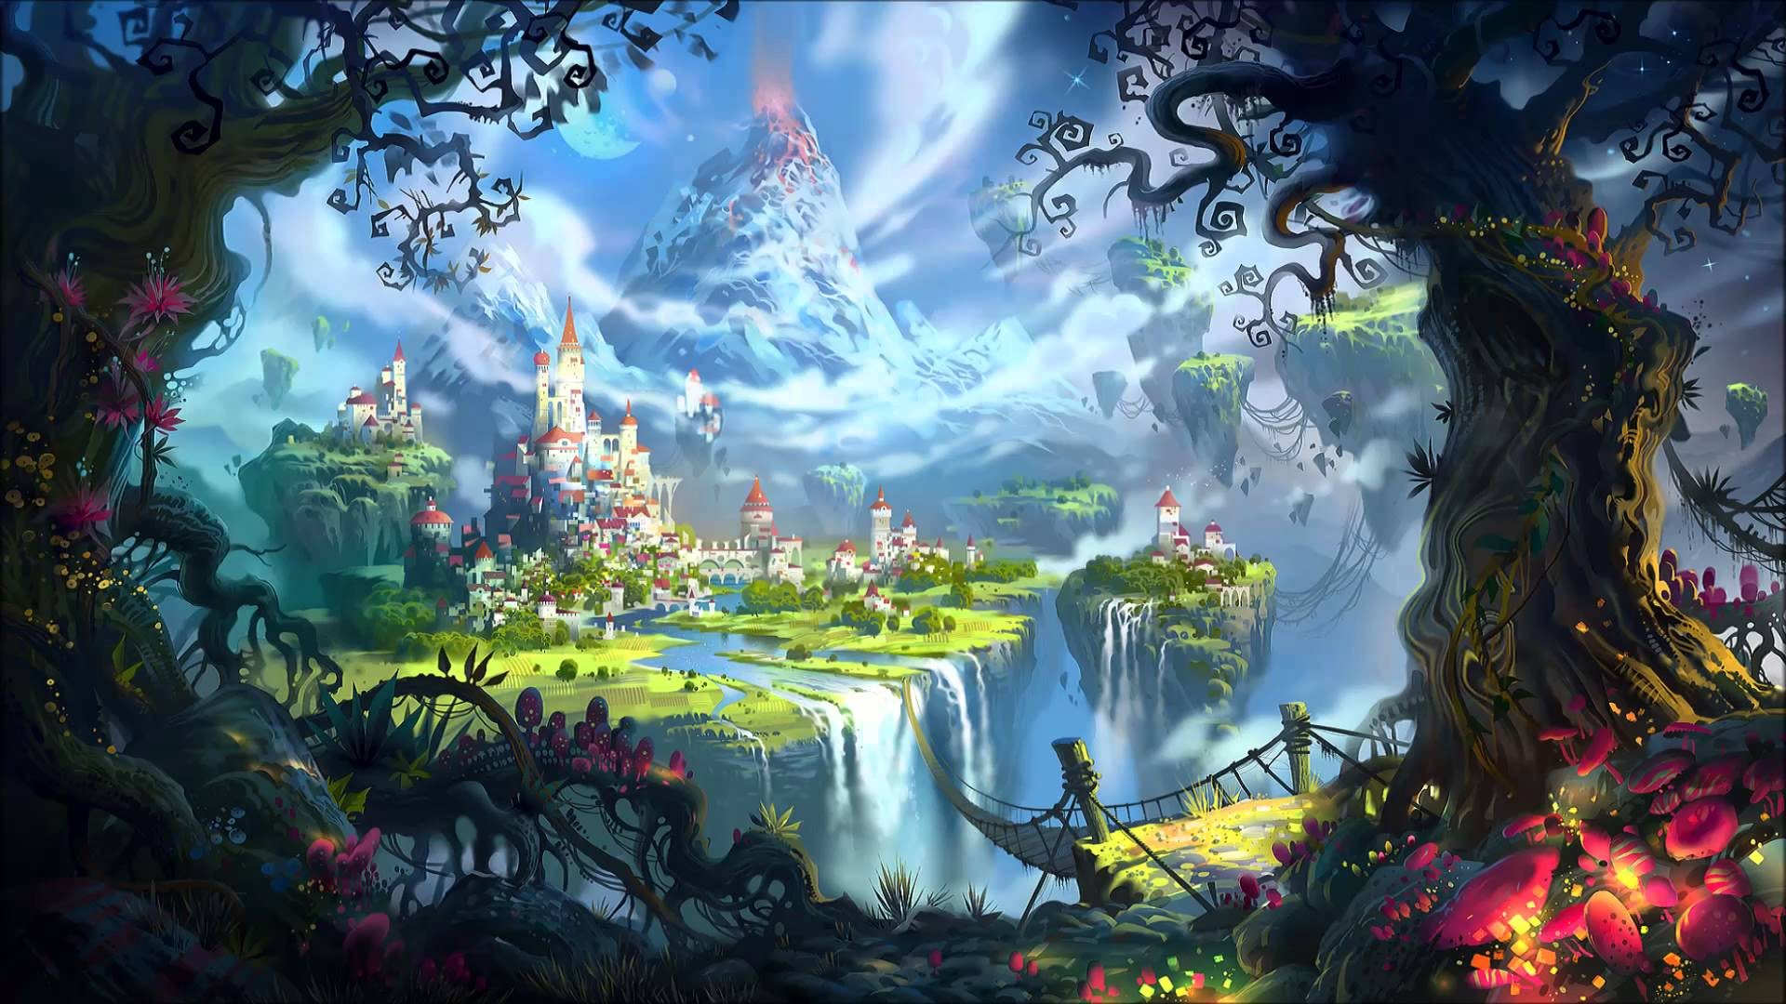
Ontology Demonstration

